Slide 1


Slide 2
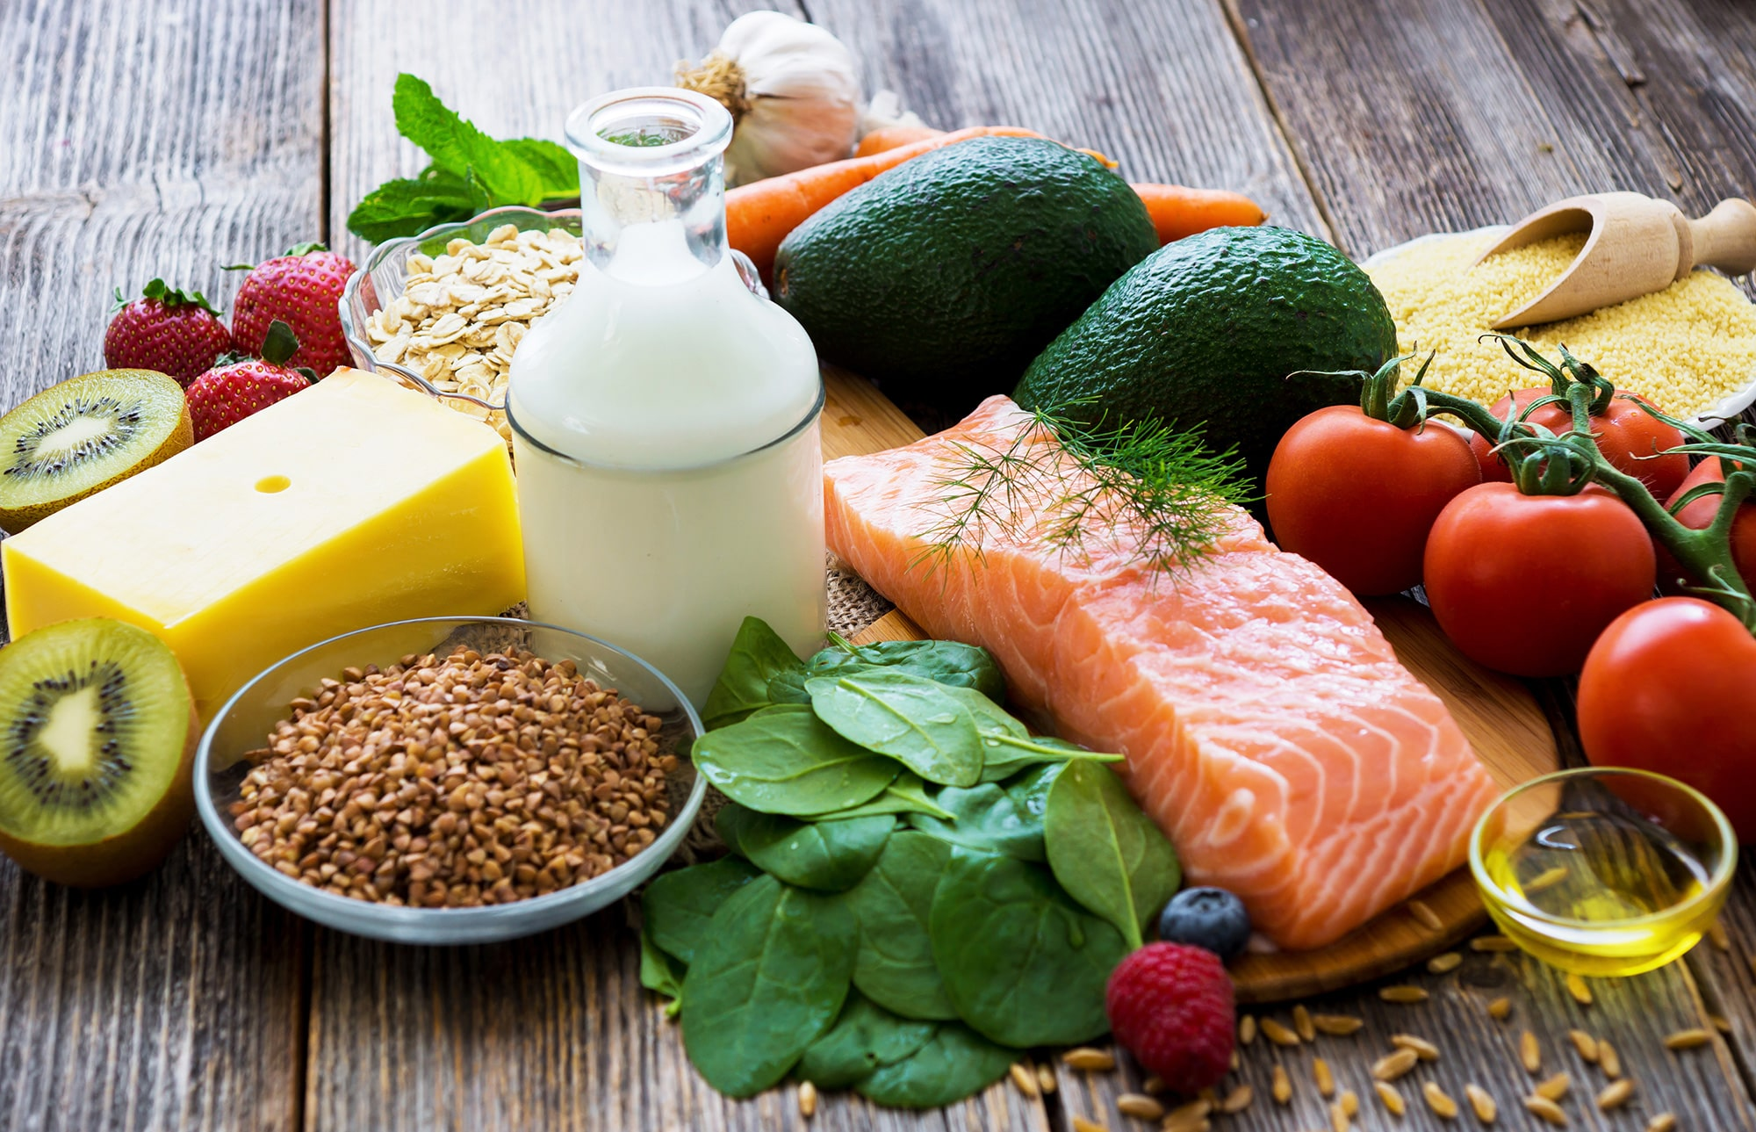
Healthy

Slide 3
WHAT IS HEALTHY FOOD?

Slide 4




WHERE DO NUTRIENTS COME FROM?
FRUIT AND VEGETABLE
WHOLE GRAINS
PROTEINS

Slide 5




NUTRIENTS ARE IN HEALTHY FOOD
OMEGA-3 FATTY ACIDS
ANTIOXIDANTS
VITAMINS AND MINERALS
CARBOHYDRATES

Slide 6





THE BENEFITS OF PROVIDING HEALTHY FOOD
MAY HELP YOU LIVE LONGER
STRENGTHENS BONES
KEEPS SKIN, TEETH, AND EYES HEALTHY
HELP US THINK FASTER

Slide 7
THANK YOU FOR PAY ATTENTION

